Slide 1

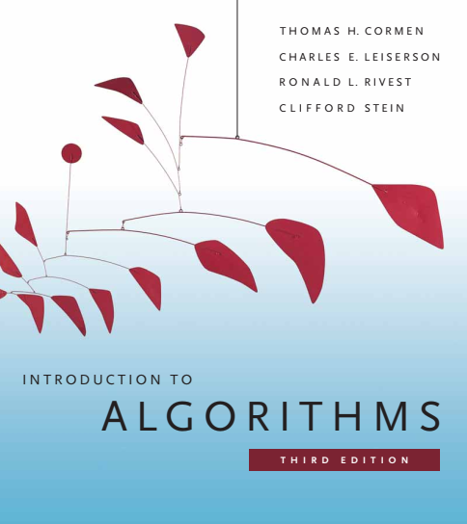
Design and Analysis of Algorithms
Dr. Sajid Iqbal
Reference Book
Introduction to Algorithms 3rd Edition By Thomas H. Cormen et. al.
https://mitpress.mit.edu/books/introduction-algorithms-third-edition
COMEDXD

Slide 2
The Sorting Algorithms
Use of The recursion method

Slide 3

Background
A sorting algorithm is a way to sort the numbers which are in an unsorted order
Why sorting?
Some applications requires data in sorted order to process it.
Sorting is required to display the data in an arranged form
A number of sorting algorithms have been developed. For comparative analysis, the sorting are required to be studied
To find the optimal method of sorting for given problem. It may depend upon
prior knowledge about the keys and satellite data,
The memory hierarchy (caches and virtual memory) of the host computer,
and the software environment.
Many of these issues are best dealt with at the algorithmic level, rather than by “tweaking” the code.
5,4,6,2,7,1,3
1,2,3,4,5,6,7

Slide 4
List of Sorting Techniques
Counting Sort
Radix Sort
Bucket Sort
ShellSort
TimSort
Comb Sort
Pigeonhole Sort
Cycle Sort
Cocktail Sort
Strand Sort
Selection Sort
Bubble Sort
Recursive Bubble Sort
Insertion Sort
Recursive Insertion Sort
Merge Sort
Iterative Merge Sort
Quick Sort
Iterative Quick Sort
Heap Sort
Bitonic Sort
Pancake sorting
Binary Insertion Sort
BogoSort or Permutation Sort
Gnome Sort
Sleep Sort – The King of Laziness / Sorting while Sleeping
Structure Sorting
Stooge Sort
Tag Sort (To get both sorted and original)
Tree Sort
….

Slide 5
Sorting Algorithms
Sorting
Internal Sorting
External Sorting
Internal Sorting: A sorting process that takes place entirely within the main memory of a computer
External Sorting: It is required when the data do not fit into the main memory of a computing device. Data is placed on a storage device and parts of data are taken for sorting.

Slide 6
Sorting Techniques to be Studied
Insertion Sort
Counting Sort
Sorts
Quick Sort
Radix Sort
Heap Sort
Bucket Sort
Merge Sort

Slide 7
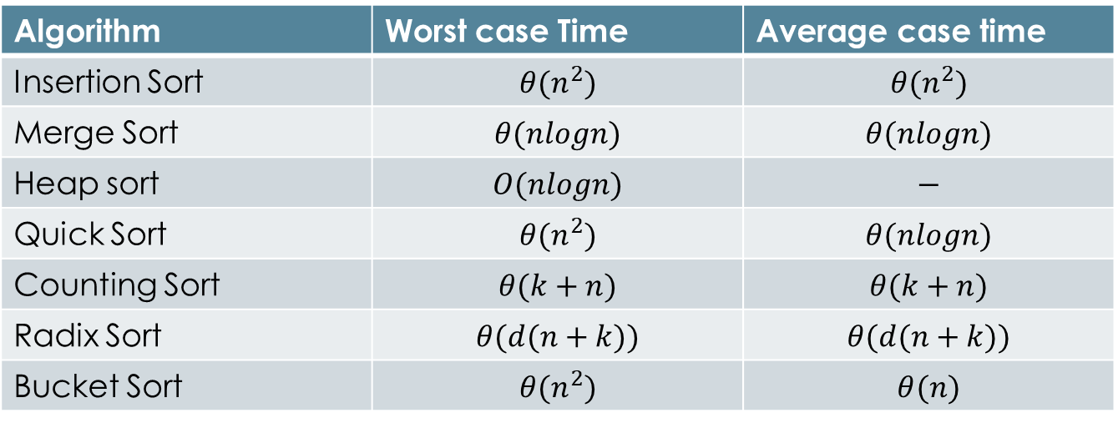
Time Complexity of Some Sorting Algorithms
Algorithm | Worst case Time | Average case time
Insertion Sort | $$θ(n^{2})$$ | $$θ(n^{2})$$
Merge Sort | $$θ(nlogn)$$ | $$θ(nlogn)$$
Heap sort | $$O(nlogn)$$ | $$−$$
Quick Sort | $$θ(n^{2})$$ | $$θ(nlogn)$$
Counting Sort | $$θ(k+n)$$ | $$θ(k+n)$$
Radix Sort | $$θ(d(n+k))$$ | $$θ(d(n+k))$$
Bucket Sort | $$θ(n^{2})$$ | $$θ(n)$$

Slide 8
Background
Break the problem into a number of subproblems that are smaller instances of the same problem
Conquer
Solve the sub-problems recursively. Solve the smallest problems directly
Combine
Combine the solutions to the subproblems into the solution for the original problem
Divide
Divide-n-Conquer consists of three phases
A recurrence is an equation or inequality that describes a function in terms of its value on smaller inputs.

Slide 9
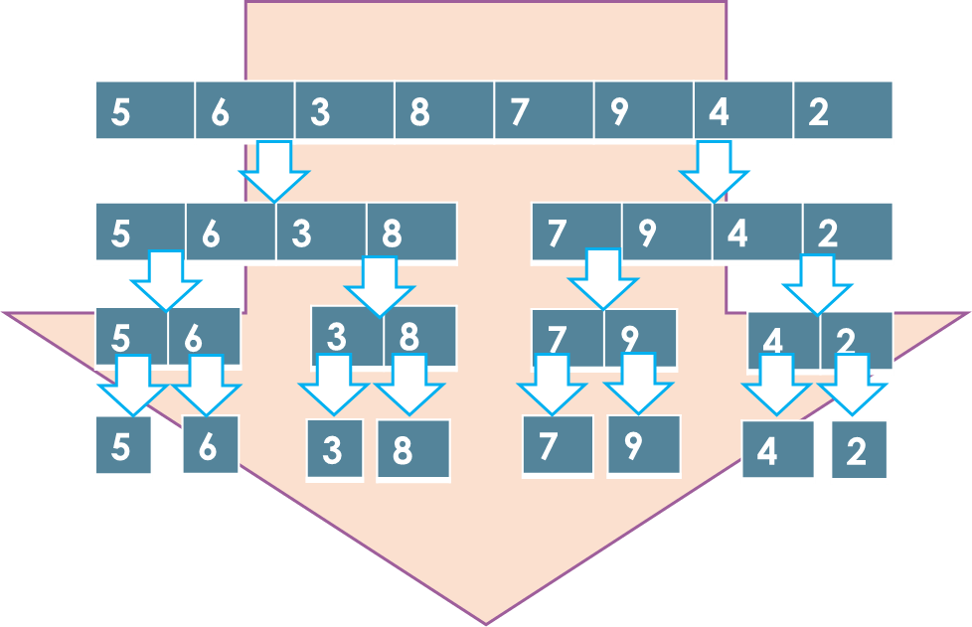

Merge Sort
The key operation of the merge sort algorithm is the merging of two sorted sequences in the “combine” step
For an unsorted array $A$
Step1: Recursively divide the list into $N$ sub-arrays such that each sub-list contains 1 element
Step2,3: Take adjacent pairs of singleton lists and merge them to form a list of two elements in such a way smaller element comes first
Now there are $\frac{N}{2}$ pairs of the list
Repeat the process (step2,3)
Forward Direction: you will get $\frac{N}{2},\frac{N}{4},\frac{N}{8}, … ,\frac{N}{N}$ sized lists.
Backward Direction:$\frac{N}{N},…,\frac{N}{8},\frac{N}{4},\frac{N}{2}, N$

Slide 10
Merge Sort
5 | 6 | 3 | 8 | 7 | 9 | 4 | 2
2 | 3 | 4 | 5 | 6 | 7 | 8 | 9
5 | 6 | 3 | 8
7 | 9 | 4 | 2
3 | 5 | 6 | 8
2 | 4 | 7 | 9
5 | 6
3 | 8
7 | 9
4 | 2
5 | 6
3 | 8
7 | 9
2 | 4
5
6
3
8
7
9
4
2
5
6
3
8
7
9
4
2

Slide 11
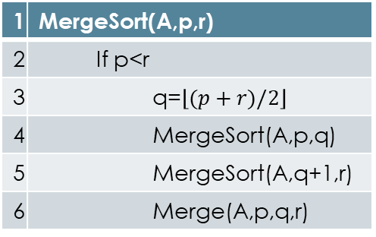

Merge Sort Algorithm
1 | 2 | 3 | 4 | 5 | 6 | 7 | 8
Let $A$ is an array to be sorted
Let $p, q, r$are start, mid and end indexes
The procedure MERGE-SORT(A, p, r) sorts the elements in the subarray A[p…r]
If $p>r$: There is no element in the array
If $p=r$: there is one element in the array
If $p<r$: find an index q that partitions the array A[p .. r] into
A[p .. q], containing $\left\lceil \frac{n}{2}\right\rceil$ elements
A[q .. r], containing $\left\lfloor \frac{n}{2}\right\rfloor$elements.
We make first call to $Merge(A,p,q,r)$
2 | 3 | 4 | 5 | 6 | 7 | 8 | 9
1 | MergeSort(A,p,r)
2 | If p<r
3 | q=$\left\lfloor (p+r)/2\right\rfloor$
4 | MergeSort(A,p,q)
5 | MergeSort(A,q+1,r)
6 | Merge(A,p,q,r)

Slide 12
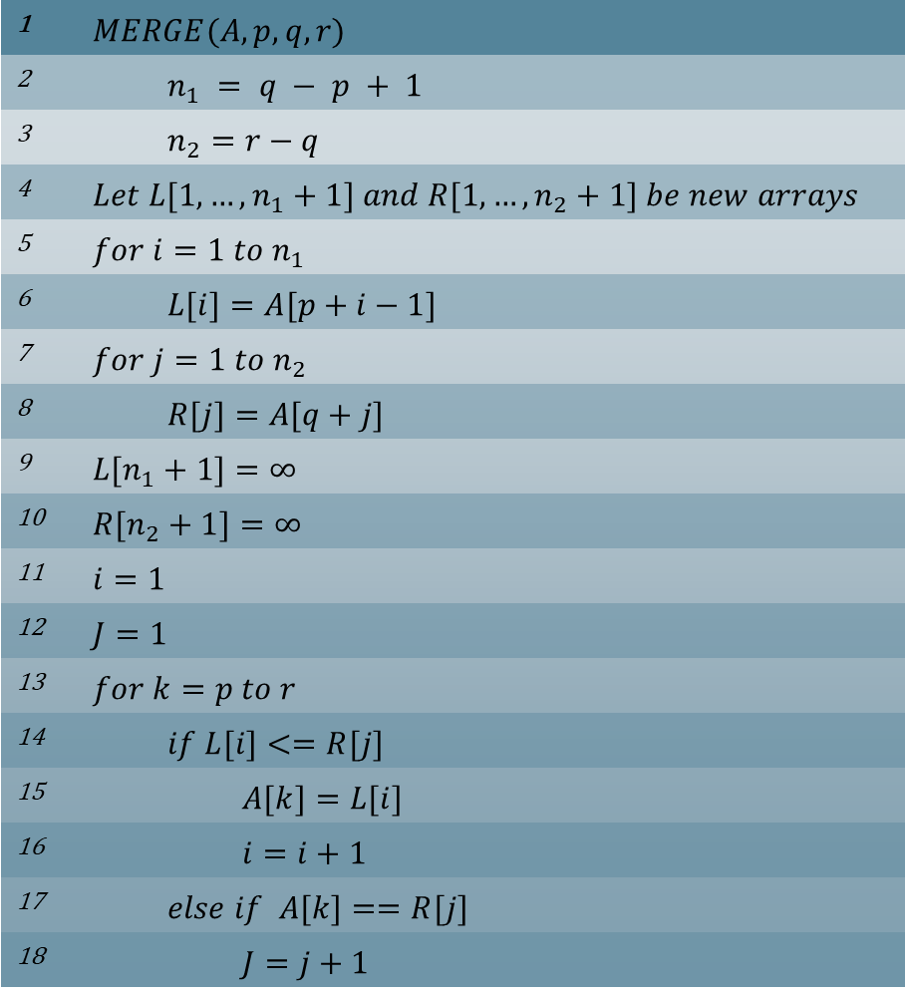
1 | $$MERGE(A, p, q, r)$$
2 | $$n_{1} = q − p + 1$$
3 | $$n_{2}=r−q$$
4 | $$Let L[1,…,n_{1}+1] and R[1,…,n_{2}+1] be new arrays$$
5 | $$for i=1 to n_{1}$$
6 | $$L[i]=A[p+i−1]$$
7 | $$for j=1 to n_{2}$$
8 | $$R[j]=A[q+j]$$
9 | $$L[n_{1}+1]=∞$$
10 | $$R[n_{2}+1]=∞$$
11 | $$i=1$$
12 | $$J=1$$
13 | $$for k=p to r$$
14 | $$if L[i]<=R[j]$$
15 | $$A[k]=L[i]$$
16 | $$i=i+1$$
17 | $$else if A[k]==R[j]$$
18 | $$J=j+1$$
1 | 2 | 3 | 4 | 5 | 6 | 7 | 8
2 | 3 | 4 | 5 | 6 | 7 | 8 | 9
3 | 5 | 6 | 8
2 | 4 | 7 | 9
5 | 6
3 | 8
7 | 9
2 | 4
5
6
3
8
7
9
4
2

Slide 13
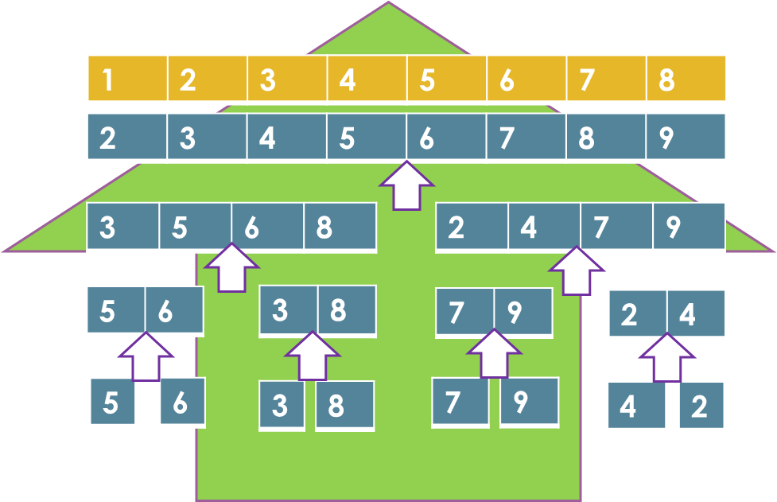
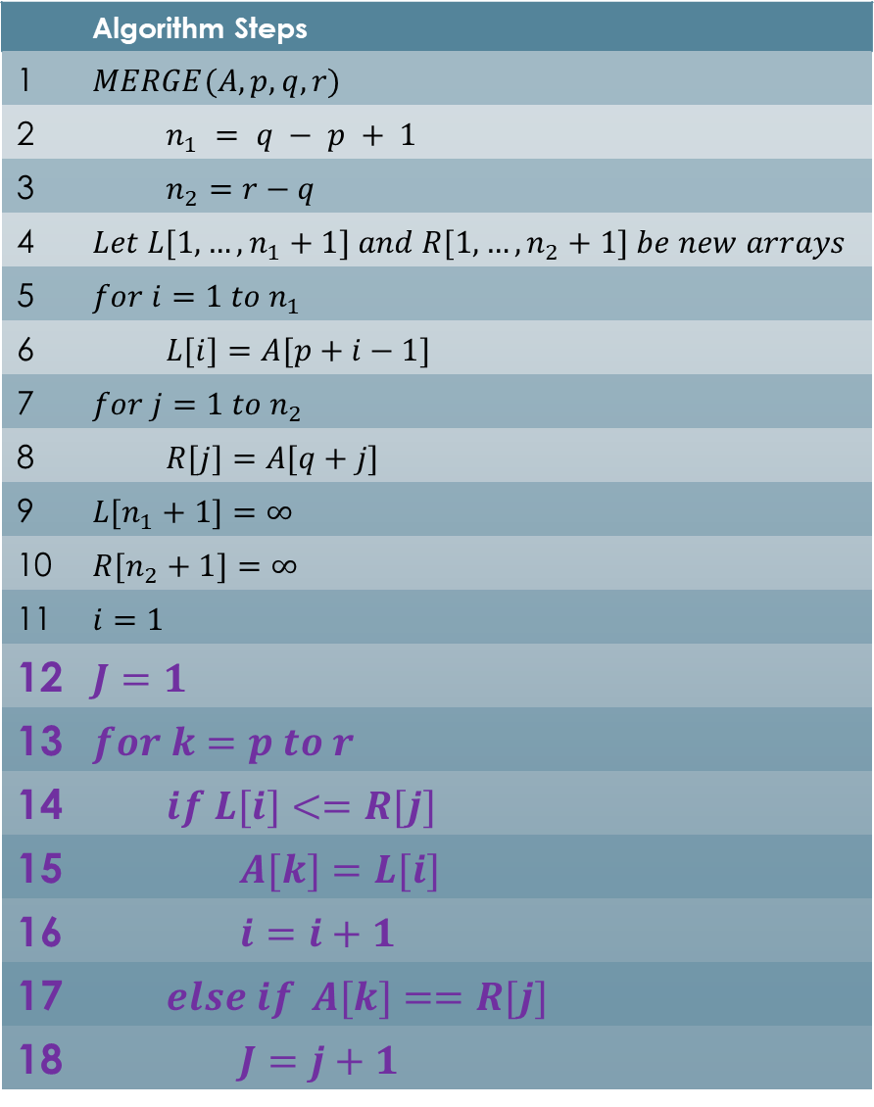
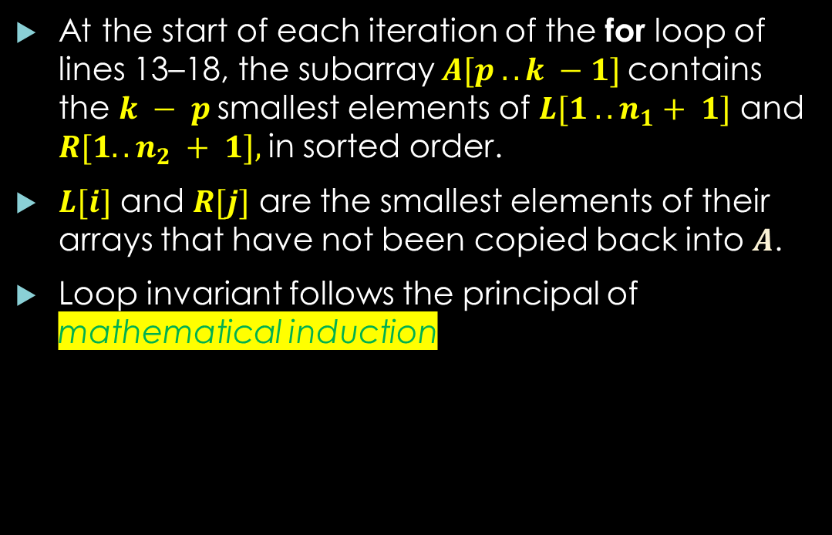
Loop Invariant
 | Algorithm Steps
1 | $$MERGE(A, p, q, r)$$
2 | $$n_{1} = q − p + 1$$
3 | $$n_{2}=r−q$$
4 | $$Let L[1,…,n_{1}+1] and R[1,…,n_{2}+1] be new arrays$$
5 | $$for i=1 to n_{1}$$
6 | $$L[i]=A[p+i−1]$$
7 | $$for j=1 to n_{2}$$
8 | $$R[j]=A[q+j]$$
9 | $$L[n_{1}+1]=∞$$
10 | $$R[n_{2}+1]=∞$$
11 | $$i=1$$
12 | $$J=1$$
13 | $$for k=p to r$$
14 | $$if L[i]<=R[j]$$
15 | $$A[k]=L[i]$$
16 | $$i=i+1$$
17 | $$else if A[k]==R[j]$$
18 | $$J=j+1$$
At the start of each iteration of the for loop of lines 13–18, the subarray $A[p .. k −1]$contains the $k − p$smallest elements of $L[1 .. n_{1}+ 1]$ and $R[1.. n_{2} + 1],$in sorted order.
$L[i]$ and $R[j]$ are the smallest elements of their arrays that have not been copied back into $A$.
Loop invariant follows the principal of mathematical induction

Slide 14


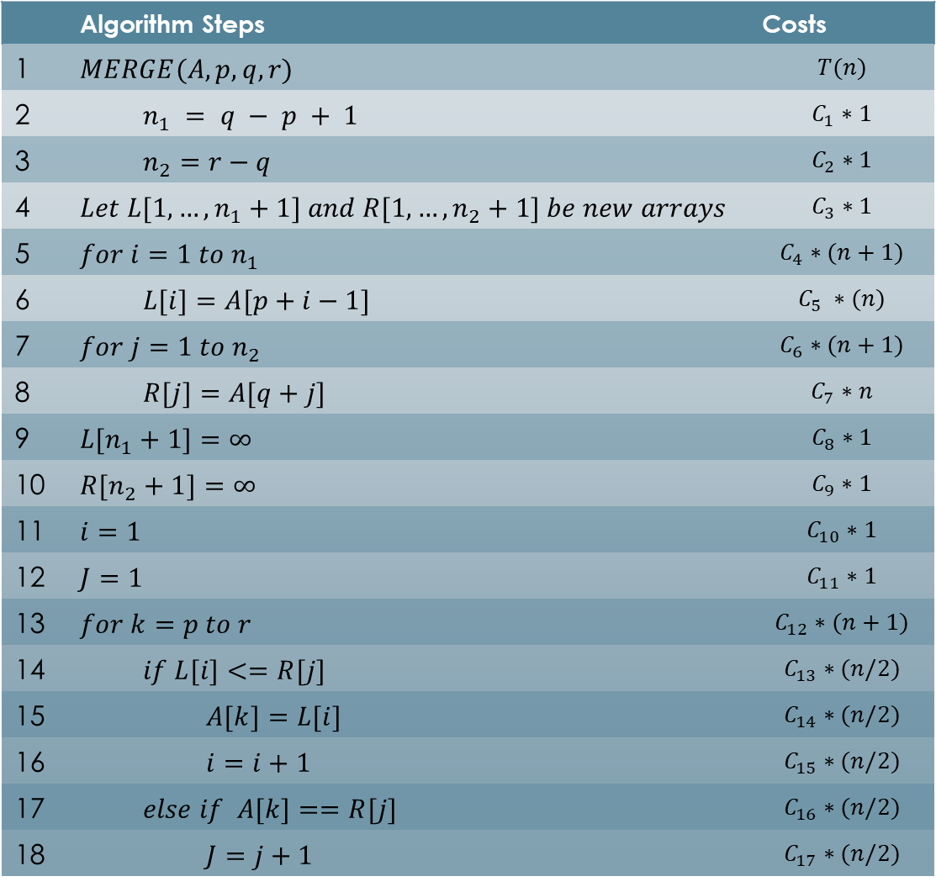
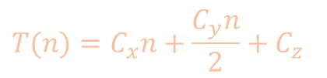
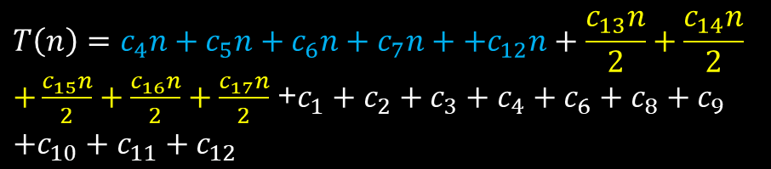
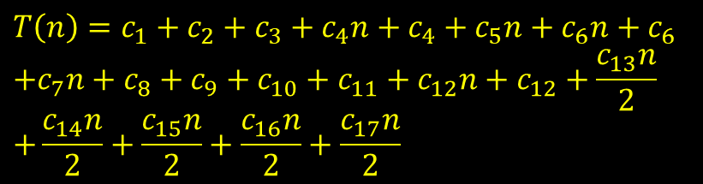
Merge Sort Analysis
 | Algorithm Steps | Costs
1 | $$MERGE(A, p, q, r)$$ | $$T(n)$$
2 | $$n_{1} = q − p + 1$$ | $$C_{1}∗1$$
3 | $$n_{2}=r−q$$ | $$C_{2}∗1$$
4 | $$Let L[1,…,n_{1}+1] and R[1,…,n_{2}+1] be new arrays$$ | $$C_{3}∗1$$
5 | $$for i=1 to n_{1}$$ | $$C_{4}∗(n+1)$$
6 | $$L[i]=A[p+i−1]$$ | $$C_{5} ∗(n)$$
7 | $$for j=1 to n_{2}$$ | $$C_{6}∗(n+1)$$
8 | $$R[j]=A[q+j]$$ | $$C_{7}∗n$$
9 | $$L[n_{1}+1]=∞$$ | $$C_{8}∗1$$
10 | $$R[n_{2}+1]=∞$$ | $$C_{9}∗1$$
11 | $$i=1$$ | $$C_{10}∗1$$
12 | $$J=1$$ | $$C_{11}∗1$$
13 | $$for k=p to r$$ | $$C_{12}∗(n+1)$$
14 | $$if L[i]<=R[j]$$ | $$C_{13}∗(n/2)$$
15 | $$A[k]=L[i]$$ | $$C_{14}∗(n/2)$$
16 | $$i=i+1$$ | $$C_{15}∗(n/2)$$
17 | $$else if A[k]==R[j]$$ | $$C_{16}∗(n/2)$$
18 | $$J=j+1$$ | $$C_{17}∗(n/2)$$
$$T\left(n\right)=c_{1}∗1+c_{2}∗1+c_{3}∗1+c_{4}∗\left(n+1\right)$$
$$+c_{5}∗n+c_{6}∗\left(n+1\right)+c_{7}∗n+c_{8}∗1+c_{9}∗1$$
$$+c_{10}∗1+c_{11}∗1+c_{12}∗\left(n+1\right)+c_{13}∗\left(\frac{n}{2}\right)$$
$$+c_{14}∗(n/2)+c_{15}∗(n/2)+c_{16}∗(n/2)$$
$$+c_{17}∗(n/2)$$
$$T\left(n\right)=c_{1}+c_{2}+c_{3}+c_{4}n+c_{4}+c_{5}n+c_{6}n+c_{6}$$
$$+c_{7}n+c_{8}+c_{9}+c_{10}+c_{11}+c_{12}n+c_{12}+\frac{c_{13}n}{2}$$
$$+\frac{c_{14}n}{2}+\frac{c_{15}n}{2}+\frac{c_{16}n}{2}+\frac{c_{17}n}{2}$$
$$T\left(n\right)=c_{4}n+c_{5}n+c_{6}n+c_{7}n++c_{12}n+\frac{c_{13}n}{2}+\frac{c_{14}n}{2}$$
$+\frac{c_{15}n}{2}+\frac{c_{16}n}{2}+\frac{c_{17}n}{2}$ +$c_{1}+c_{2}+c_{3}+c_{4}+c_{6}+c_{8}+c_{9}$
$$+c_{10}+c_{11}+c_{12}$$
$$T(n)=C_{x}n+\frac{C_{y}n}{2}+C_{z}$$
$T(n)=Cn+C_{z}$ =$Cn$ $=θ(n)$

Slide 15
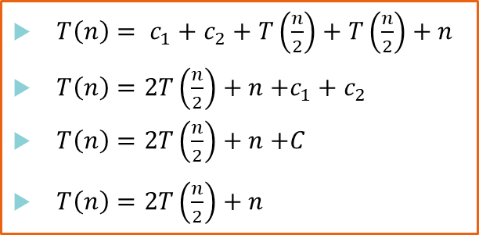
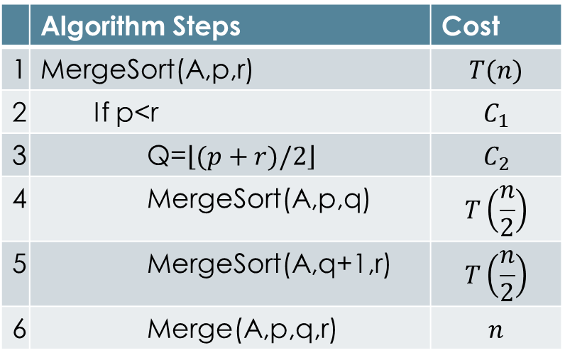
Merge Sort Analysis
 | Algorithm Steps | Cost
1 | MergeSort(A,p,r) | $$T(n)$$
2 | If p<r | $$C_{1}$$
3 | Q=$\left\lfloor (p+r)/2\right\rfloor$ | $$C_{2}$$
4 | MergeSort(A,p,q) | $$T\left(\frac{n}{2}\right)$$
5 | MergeSort(A,q+1,r) | $$T\left(\frac{n}{2}\right)$$
6 | Merge(A,p,q,r) | $$n$$
$T\left(n\right)= c_{1}+c_{2}+T\left(\frac{n}{2}\right)+T\left(\frac{n}{2}\right)+n$
$T\left(n\right)=2T\left(\frac{n}{2}\right)+n$ $+c_{1}+c_{2}$
$T\left(n\right)=2T\left(\frac{n}{2}\right)+n$ $+C$
$T\left(n\right)=2T\left(\frac{n}{2}\right)+n$

Slide 16
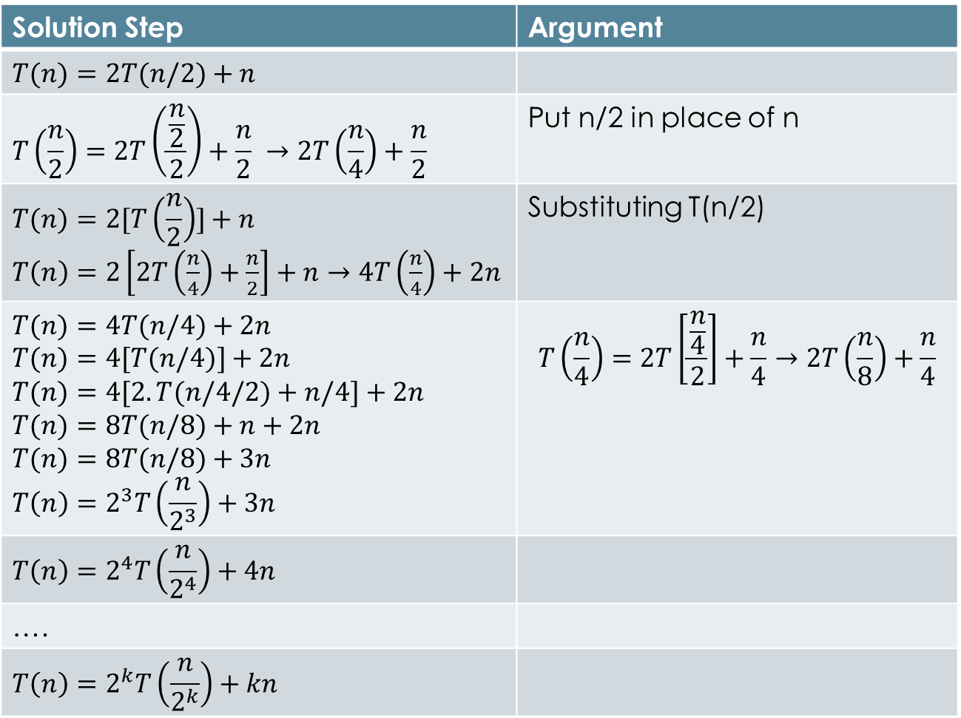
Solving the recursion
Solution Step | Argument
$$T(n)=2T(n/2)+n$$
$$T\left(\frac{n}{2}\right)=2T\left(\frac{\frac{n}{2}}{2}\right)+\frac{n}{2} →2T\left(\frac{n}{4}\right)+\frac{n}{2}$$ | Put n/2 in place of n
$$T(n)=2[T\left(\frac{n}{2}\right)]+n$$ $T\left(n\right)=2\left[2T\left(\frac{n}{4}\right)+\frac{n}{2}\right]+n→4T\left(\frac{n}{4}\right)+2n$ | Substituting T(n/2)
$$T(n)=4T(n/4)+2n$$ $$T(n)=4[T(n/4)]+2n$$ $$T(n)=4[2.T(n/4/2)+n/4]+2n$$ $$T(n)=8T(n/8)+n+2n$$ $$T(n)=8T(n/8)+3n$$ $$T\left(n\right)=2^{3}T\left(\frac{n}{2^{3}}\right)+3n$$ | $$T\left(\frac{n}{4}\right)=2T\left[\frac{\frac{n}{4}}{2}\right]+\frac{n}{4}→2T\left(\frac{n}{8}\right)+\frac{n}{4}$$
$$T\left(n\right)=2^{4}T\left(\frac{n}{2^{4}}\right)+4n$$
….
$$T\left(n\right)=2^{k}T\left(\frac{n}{2^{k}}\right)+kn$$

Slide 17
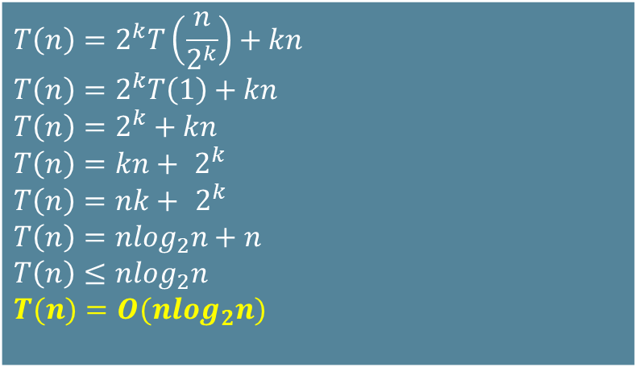

Solving the recursion
By expanding the expression this way will reach to a point where $2^{k}=n$
At this point $T\left(\frac{n}{2^{k}}\right)=T\left(1\right)$
$2^{k}=n →\log_{2}{n}=k$ ($2^{3}=8 →\log_{2}{8}=3$)
$$T\left(n\right)=2^{k}T\left(\frac{n}{2^{k}}\right)+kn$$ $$T\left(n\right)=2^{k}T\left(1\right)+kn$$ $$T\left(n\right)=2^{k}+kn$$ $$T\left(n\right)={kn+ 2}^{k}$$ $$T\left(n\right)={nk+ 2}^{k}$$ $$T\left(n\right)=nlog_{2}n+n$$ $$T\left(n\right)≤nlog_{2}n$$ $$T(n)=O(nlog_{2}n)$$

Slide 18
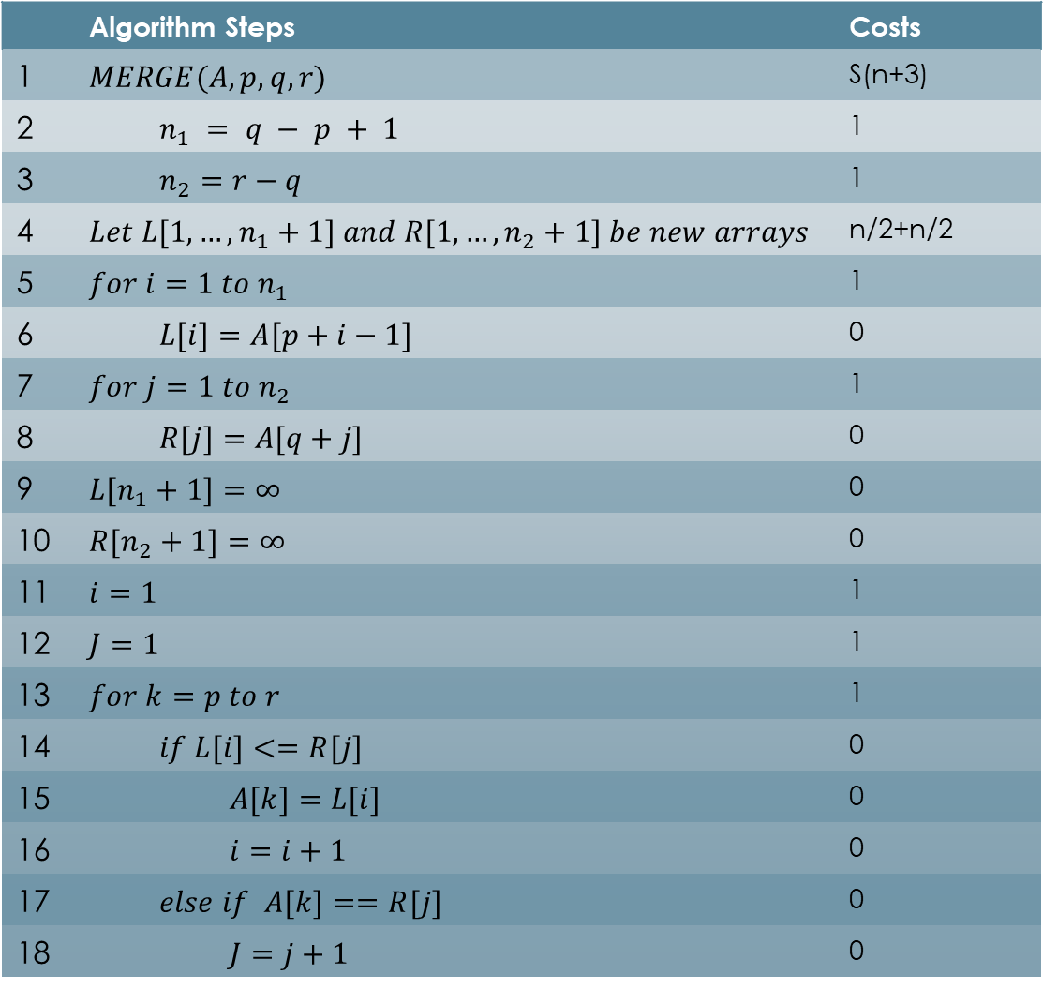

Space Complexity
 | Algorithm Steps | Costs
1 | $$MERGE(A, p, q, r)$$ | S(n+3)
2 | $$n_{1} = q − p + 1$$ | 1
3 | $$n_{2}=r−q$$ | 1
4 | $$Let L[1,…,n_{1}+1] and R[1,…,n_{2}+1] be new arrays$$ | n/2+n/2
5 | $$for i=1 to n_{1}$$ | 1
6 | $$L[i]=A[p+i−1]$$ | 0
7 | $$for j=1 to n_{2}$$ | 1
8 | $$R[j]=A[q+j]$$ | 0
9 | $$L[n_{1}+1]=∞$$ | 0
10 | $$R[n_{2}+1]=∞$$ | 0
11 | $$i=1$$ | 1
12 | $$J=1$$ | 1
13 | $$for k=p to r$$ | 1
14 | $$if L[i]<=R[j]$$ | 0
15 | $$A[k]=L[i]$$ | 0
16 | $$i=i+1$$ | 0
17 | $$else if A[k]==R[j]$$ | 0
18 | $$J=j+1$$ | 0
$Total space for Merge$
$\left(n+3\right)+\frac{n}{2}+\frac{n}{2}+7=2n+10$

Slide 19
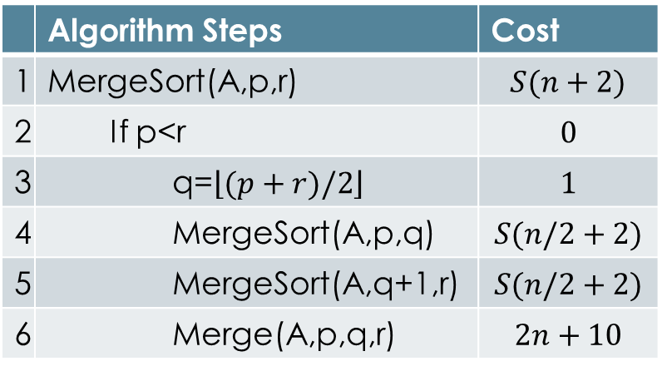

Space Complexity
$S\left(n+2\right)=2S\left(\frac{n}{2}+2\right)+2n+11$
$S\left(n\right)=2S\left(\frac{n}{2}\right)+2n$
$S\left(n\right)=2S\left(\frac{n}{2}\right)+n$
$S\left(n\right)=nlog_{2}n \left(including stack space\right)$
However the code runs in depth first mode so the space used by instruction 4, will also be utilized by instruction 6.
$S(n)=S(\frac{n}{2})+n$
$S(n)=O(n)+O(n)=O(n)$
 | Algorithm Steps | Cost
1 | MergeSort(A,p,r) | $$S(n+2)$$
2 | If p<r | $$0$$
3 | q=$\left\lfloor (p+r)/2\right\rfloor$ | $$1$$
4 | MergeSort(A,p,q) | $$S(n/2+2)$$
5 | MergeSort(A,q+1,r) | $$S(n/2+2)$$
6 | Merge(A,p,q,r) | $$2n+10$$

Slide 20
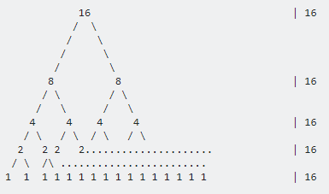
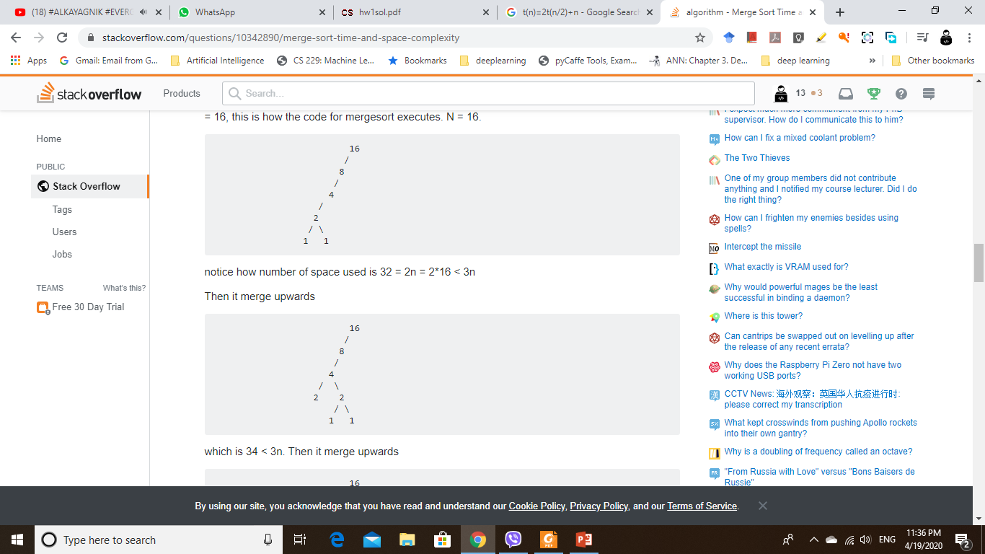
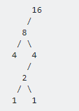

Space Complexity
First picture shown space complexity $nlog_{2}n$
However in actual it remains $≤3n$ for any branch

Slide 21

Thanks for watching
Dr. Sajid Iqbal
Assistant Professor
Department of Computer Science
Bahauddin Zakariya University, Multan
sajidiqbal.pk@gmail.com
YouTube Channel: COMEDXD
Allah Hafiz

